Slide 1

Group 2’s Bacchus Case Study
By Jasmine Fontus, Noah McCarthy, Suresh Shrestha

Slide 2
Desc.
This case study is to help Stan and Davis, who run a winery, get information for their yearly ‘snapshot’ of the business. The information they need is:
Are all suppliers delivering on time? Is there a large gap between expected delivery and actual delivery? A month-by-month report should show problem areas.
The wine distribution, are all wines selling as they thought? Is one wine not selling? Which distributor carries which wine?
Employee time. During the last four quarters, how many hours did each employee work?

Slide 3
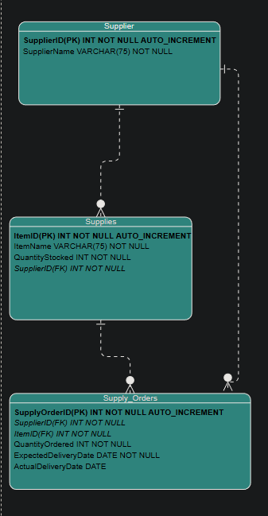
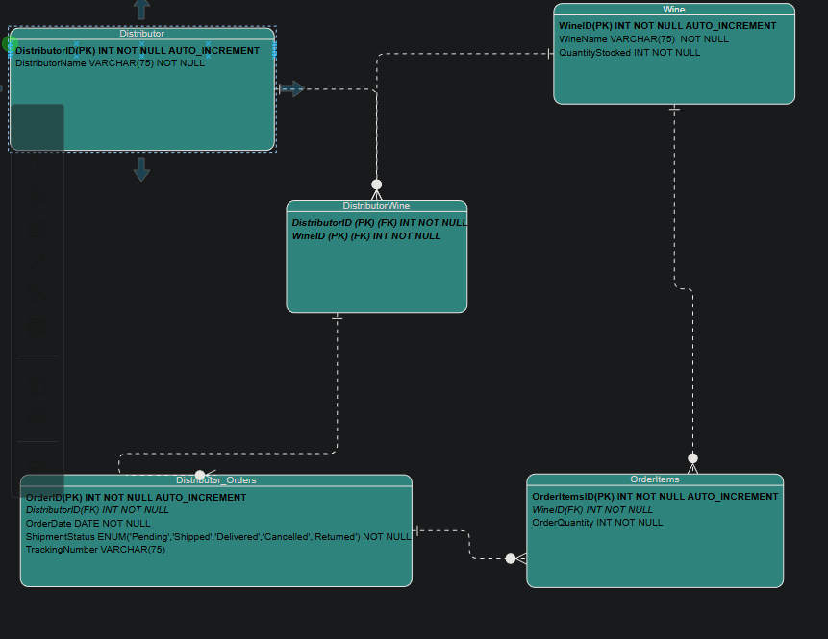
ERD

Slide 4
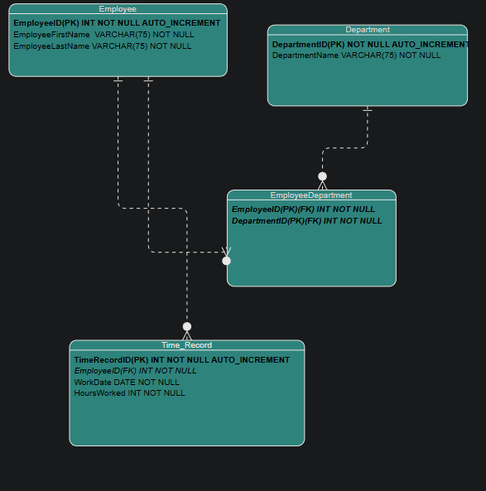
ERD continued

Slide 5
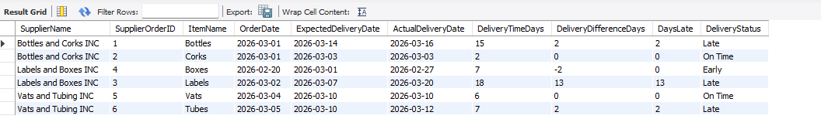
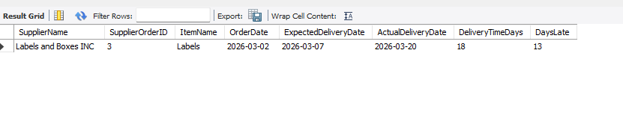
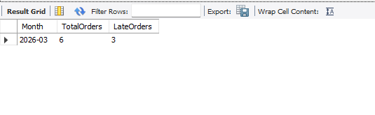
Are Supplier Delivering on Time?

Slide 6
Are All Wine Selling as They Thought?
To answer this question, we need to query their database of Wines, which wines the Distributors carry, and the order history.
SELECT w.WineName, COALESCE(SUM(oi.OrderQuantity),0) AS TotalOrderedLastMonth #Coalesce turns Null into 0 in this case
FROM Wine w
LEFT JOIN OrderItems oi # use left joins so any wine not sold is still visible
ON w.WineID = oi.WineID
LEFT JOIN Distributor_Orders o
ON oi.OrderID = o.OrderID
AND o.OrderDate >= DATE_SUB(CURDATE(), INTERVAL 1 MONTH) #takes todays date and subtracts month to determine if it is in range
GROUP BY w.WineID, w.WineName;
"SELECT * FROM Wine;" # display Wines in stock records

Slide 7
Query Continued
SELECT d.DistributorName, w.WineName
FROM Distributor d
JOIN DistributorWine dw #Joins the DistributorWine table that stores wines they carry with the Distributor Table to display the distributorname with the wine they carry
ON d.DistributorID = dw.DistributorID
JOIN Wine w #Joins Wine Table to include the WineName with the distributorname output
ON dw.WineID = w.WineID
ORDER BY d.DistributorName, w.WineName;

Slide 8
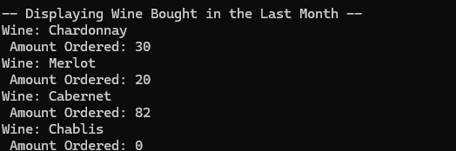
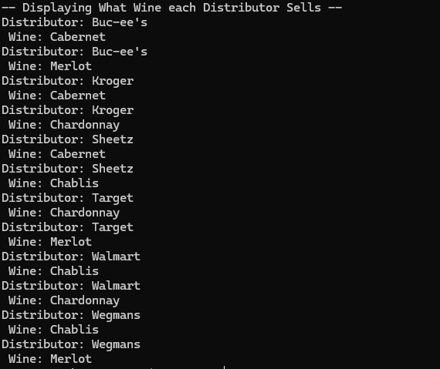
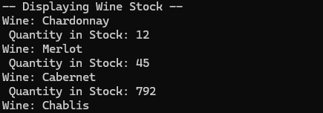
Image of the Records Pulled

Slide 9
What can Stan and Davis deduce from this data?
Well, for one thing, they didn’t sell any Chablis Wine this last month.
They know the reason for this is that they are out of stock of this wine.
They can understand which distributors are willing to buy which wine.
Eventually deduce which wine is their most popular

Slide 10
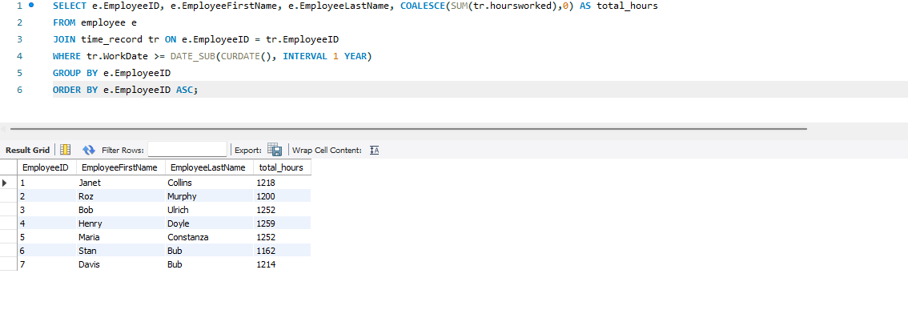
How Many Hours did Employees Work?

Slide 11
Assumptions We Made
In the wine-selling query, I assumed they wanted a limited history of the wine sold, and I assumed it to be a month.
Also, in the wine-selling query, I assumed they would want to see their wine’s stock to see if there is any reason they are not selling any wine.
On Days late we include the weekend since delivery can still happen on weekends
Each supplier provides specific supplies such as bottles, corks, labels, boxes, vats, or tubing to the winery.
The system tracks supplier delivery performance to help Bacchus Winery identify suppliers that frequently deliver late.
Each supply order has an order date, expected delivery date, and actual delivery date so the winery can track supplier performance.

